Slide 1
Future of Academic Collections: leveraging shared capacity
CAVAL
Discussion Session
25 October 2010
Constance Malpas
Program Officer, OCLC Research

Slide 2
Purpose of today’s session
Examine some key trends in US and Australian academic libraries
Summarise findings from a recent study of mass-digitised library collections, implications for academic print management
Discuss CAVAL’s role in supporting reconfiguration of library system, new library workflows

Slide 3
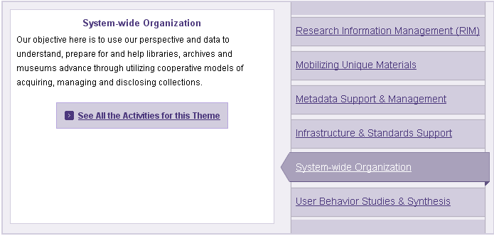
OCLC Research themes

Slide 4
System-wide organization
Research theme addresses “big picture” questions about the future of libraries in the network environment; implications for collections, services, institutions embedded in complex networks of collaboration, cooperation and exchange
Characterization of the aggregate library resource
  Collections, services, user behaviors, institutional profiles
Re-organization of individual libraries in network context
  Institutions adapting to changes in system-wide organization
Re-organization of the library system in network context
  ‘Multi-institutional’ library framework, collective adaptation

Slide 5
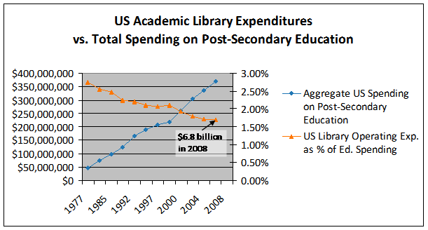
Declining Investment in Academic Libraries (US)
If this trend continues library allocations will fall below 0.5% by 2015.
Derived from : US Dept of Education, NCES, Academic Libraries Survey, 1977-2008
Notes:
US university administrations have allocated less and less of their budgets to library expenditures because the value received by the university from the library has diminished.

Slide 6
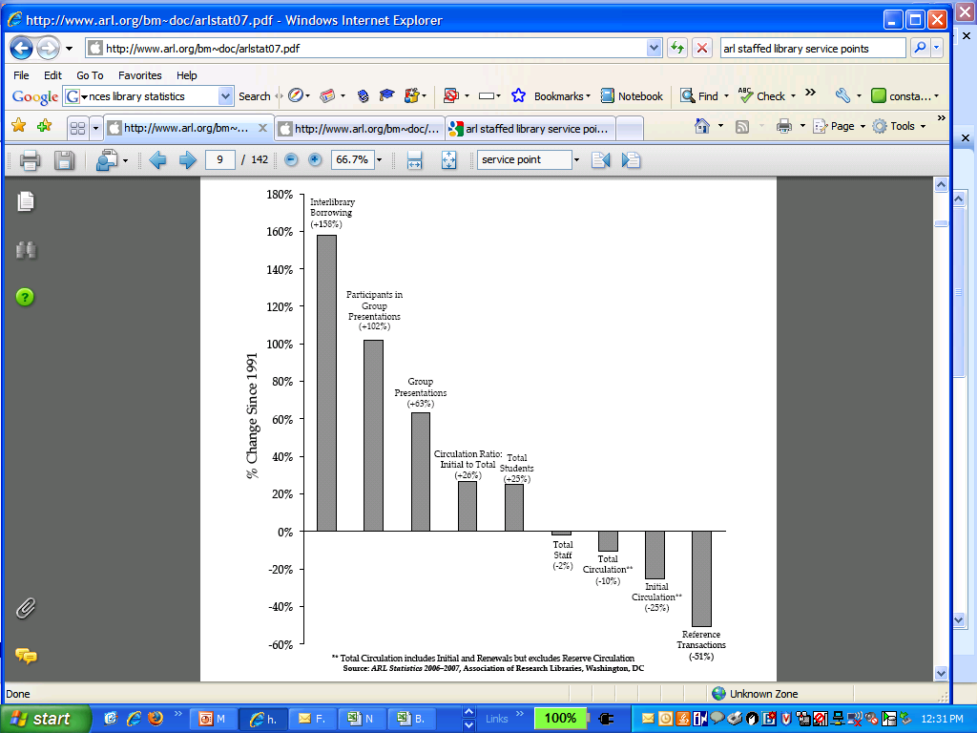
In the last 15 years (US) . . .
While student enrollment has increased (+25%) . . .
use of onsite library collections/services has decreased (-10 to -50%) . . .
and reliance on external collections has more than doubled (+150%)
Student and researcher reliance on the university library has changed
Source: “Service Trends in ARL Libraries, 1991–2007” ARL Statistics 2006–2007, Association of Research Libraries, Washington, DC
Notes:
In the last fifteen years administrators are spending less of what they have on the library because there has been a demonstrable trend in declining institutional reliance on local collections and reference services. Local collections are circulating less in both absolute and relative terms. And reliance on local library ‘expertise’ has decreased sharply.
There is little evidence that the research library community has adjusted its investments accordingly. Particularly when it comes to the purchasing or licensing of content despite lots of evidence that it is not used.

Slide 7
Change in Academic Collections
Shift to licensed electronic content is accelerating
  Research journals – a well established trend, transition near complete
  Scholarly monographs – in progress, retrospectively and prospectively
Print collections delivering less (and less) value at great (and growing) cost
  Est. $4.25 US per volume per year for on-site collections
  Library purchasing power decreasing as per-unit cost rises
Special collections marginal to educational mandate at many institutions
  Costly to manage, not (always) integral to teaching, learning
Notes:
There are a number of important changes in the academic library environment that we should be paying attention to.
First, the shift to reliance on externally sourced, licensed content is accelerating – this is no longer just about e-journals but e-books as well.
Secondly, print collections aren’t delivering the value they once did. There is increasing attention to the long term cost burden of acquiring and retaining low-use print books.
Finally, special collections are not universally perceived to be a key part of the library’s service mission in higher education. They may contain a few items regarded as treasures by the university, but the acquisition of rare books and manuscripts is rarely viewed, or funded, as a core library function.

Slide 8
An Equal and Opposite Reaction
As an increasing share of library spending is directed toward licensed content . . .
Pressure on print management costs increases
Fewer institutions to uphold preservation mandate
Stewardship roles must be reassessed
Shared service requirements will change

Slide 9
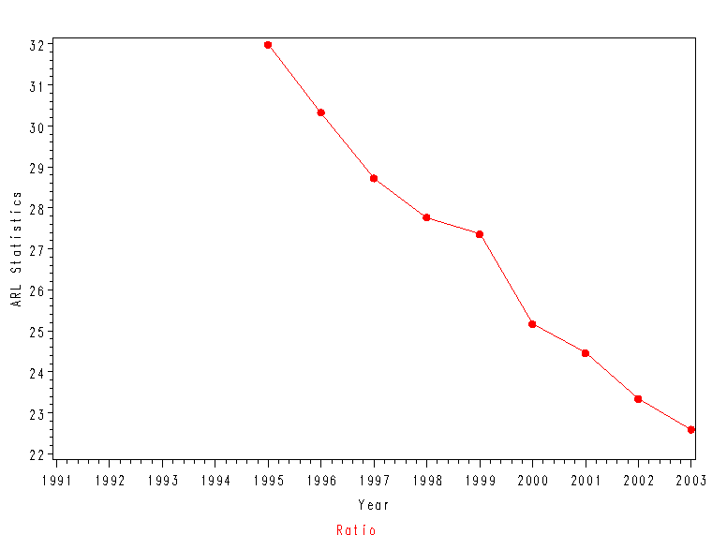
Declining circulation in US research libraries
19 loans per student per year in 2008
ARL Statistics (1995-2003)
Notes:
A 60% decline over 15 years

Slide 10
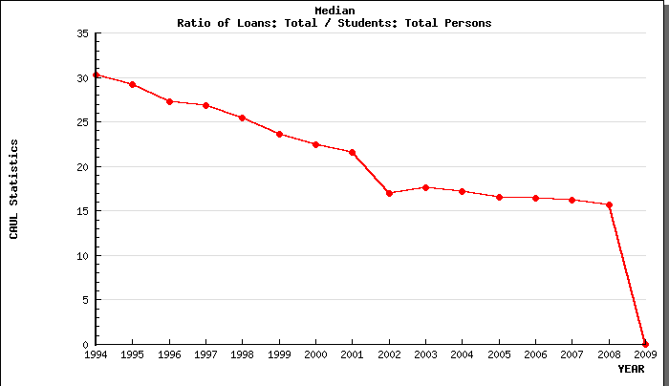
… and Australian university libraries
15 loans per student per year in 2008
Notes:
Circulation cut in half over 15 years

Slide 11
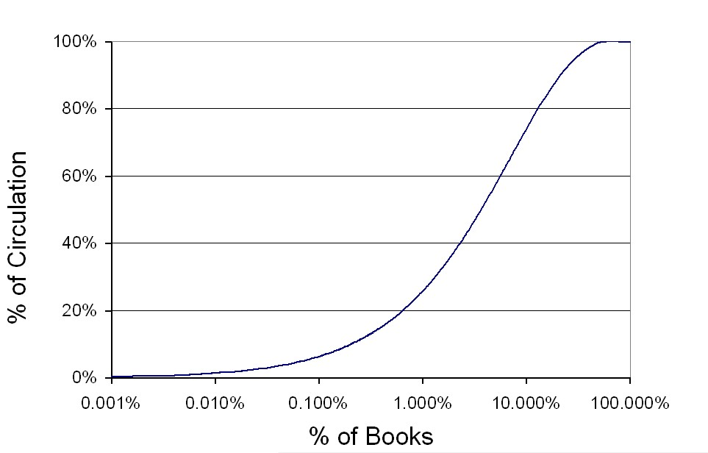
Circulation in an aggregate academic collection (US)
12.9%
OhioLINK Collections Analysis
Notes:
This is data analyzed by OCLC Research from OhioLINK, a union catalog of 88 Ohio college and university libraries. We studied the collected circulation statistics for that group over a twenty-year period. We found that it only took 13% of this union collection to support 80% of the circulation. Most of our collection is not used –ever.

Slide 12
Redundancy in an aggregate academic collection (US)
4.5
Average No. of Copies
OhioLINK Collections Analysis
Publication Date
Notes:
These data come from a recent OCLC Research study of holdings and circulation in a state-wide academic library consortium in Ohio. We looked at the holdings of 88 college and university libraries that share a direct consortial borrowing system to examine whether efforts at coordinated collection development had had an impact on duplication levels. We found that despite decades of joint work in collaborative collection development

Slide 13
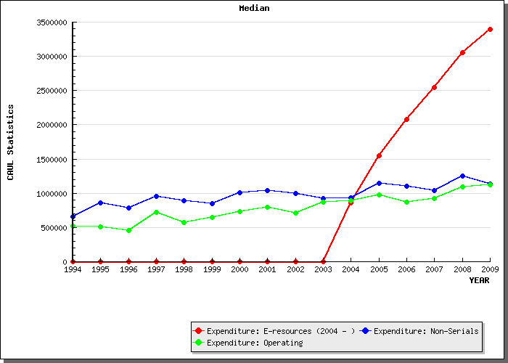
Print continues to drive operating costs
CAUL Annual Statistics, 1994-2009
Notes:
E-resources increase – but don’t affect operating expenses.

Slide 14
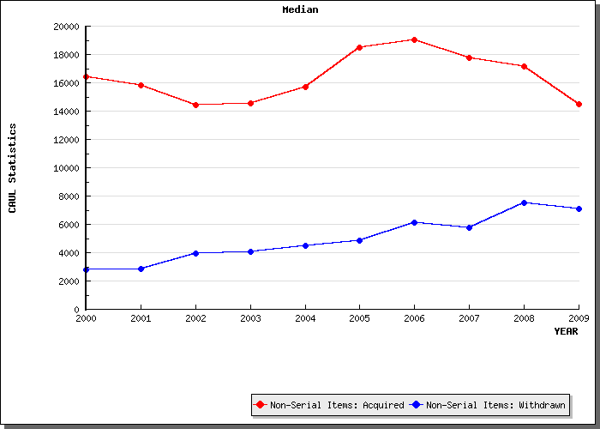
Libraries adding less, withdrawing more print
7,532 vols.
846 titles
withdrawn in 2008
Derived from CAUL Annual Statistics, 2000-2008

Slide 15
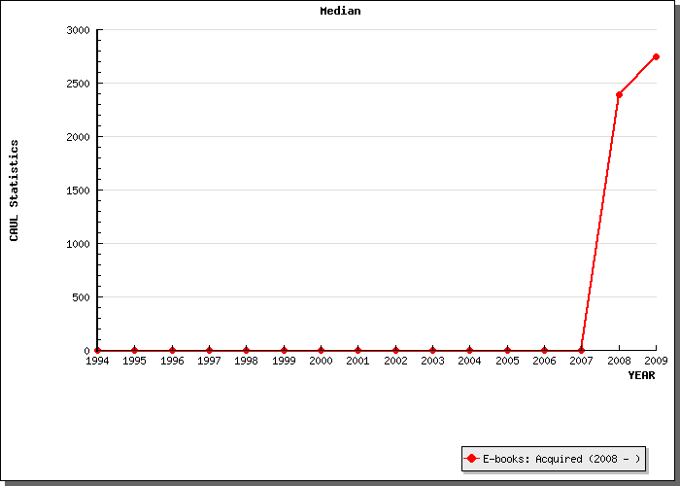
E-book acquisition (licensing) is accelerating
~2,500 titles in 2008

Slide 16
Medium | Discounted Life Cycle Cost (per unit) | Total Life Cycle Cost (per unit) | Purchase Cost (per unit) | Total Cost / Purchase Cost (per unit)
Monographs | $ 119.56 | $ 343.03 | $ 47.78 | 718%
Current serials | $ 634.91 | 801.87 | 590.97 | 134
Microforms | $ 0.27 | 0.45 | 0.11 | 256
Govt. Docs | $ 14.13 | 55.40 | 0.00 | 311
MSS & Archives | $ 20.26 | 126.79 | 4.46 | 1130
Maps | $ 26.78 | 73.82 | 11.05 | 247
Graphic materials | $ 1.65 | 2.91 | 0.06 | 216216
Sound recordings | $ 22.64 | 24.77 | 6.80 | 219
Video & Film | $ 128.95 | 107.50 | 15.70 | 307
Computer files | $ 0.17 | 0.07 | 0.01 | 331
“monographs are overwhelmingly the largest
source or driver of library costs . . . If research libraries
want to control their costs, they must work to control
and reduce the life cycle costs of maintaining their
monograph collections”
Lawrence , Connaway & Brigham (2001)
Potential life-cycle
cost savings of
(119.56-47.78)*500,000 titles
=$35,890,000
S. Lawrence et al. (2001) Based on 1999 ARL Data

Slide 17
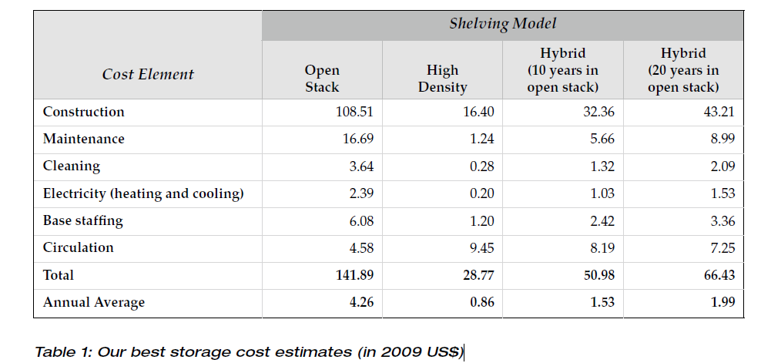
Inertia: a hidden cost driver?
Cost of management decreases as collections move off-site; the sooner they leave, the greater the savings
If 13% of on-campus collection circulates, more than 80% of the expenditure on locally managed collections delivers ‘symbolic’ value
Source: P. Courant and M. Nielson (CLIR, 2010)

Slide 18
… the books have left the building
In North America, +70M volumes off-site (2007)
~30-50% of print inventory at many major universities
Growth in US library storage infrastructure
Derived from L. Payne (OCLC, 2007)
Notes:
In fact, more and more of it is at the periphery.
In the past 25 years, massive growth in off-site library storage infrastructure in the US.

Slide 19
Forecast: E-book availability
Current*
Segment
Five Years*
Ten Years#
Front
Back
25%
Trade:
85%
50%
100%
10%
Acad/Prof:
75%
30%
100%
Text books:
20%
College:
90%
10%
100%
1%
H/S:
20%
5%
50%
*Assumes top tier publishers – 1,000 active publishers
# Assumes any active publisher selling on Amazon.com
OCLC work commissioned from Michael Cairns, Information Media Partners. Based on interviews with selection of industry experts.
Notes:
19
The publishers are expecting this switch. In private market research in the US the top tier publishers all assumed that they would be 100% electronic in their publication lists within ten years.

Slide 20


What if:
Academic libraries could “outsource” management of
low-use legacy print collections to shared service
providers
  Cooperative management of print inventory
  Joint curation of digitised library content
Key elements of infrastructure already exist:
  Off-site library storage collections
  Shared digital repository (HathiTrust)

Slide 21
Moving Collections “to the Cloud” (2009/10)
Premise: emergence of large scale shared print and
digital repositories creates opportunity for strategic
externalization* of core library operations
  Reduce costs of preserving scholarly record
  Enable reallocation of institutional resources
  Model new business relationships among libraries
* increased reliance on external infrastructure and service platforms in response to economic imperative (lower transaction costs)
Notes:
Over the last year, we have been looking closely at the mass-digitized book corpus in the context of the system-wide print book collection. There is a generally received view that the increasing ubiquity of digitized books will destabilize the academic library enterprise, and result in a rapid acceleration in the removal of print books from college and university collections.
We have been looking for evidence that might suggest the degree to which academic libraries might begin to ‘outsource’ management of the retrospective book collection to large scale print and digital suppliers. This is the scenario that Carol described earlier, in which research institutions pool print collections in shared repositories.

Slide 22



Orientation
New York University
  Top-tier research institution with global presence (Abu Dhabi)
  Library holdings in excess of 5M volumes in 2007-2008
  Limited space, preservation mandate
  Major library renovation in 2010
Research Collections Access & Preservation Consortium
  Shared high-density storage facility serving Columbia University, Princeton University, New York Public Library
  Holdings in excess of 8 million items in June 2010
HathiTrust
  Shared digital repository serving 30+ university libraries
  Joint curation of digitised library content
  Holdings in excess of 3.6M volumes in June 2010
??
Notes:
NYU total library expenditures in 2007-2008 exceeded $45M – more than Monash, which spends more than any other Australian university library (according to CAUL statistics). NYU ranks 12th in ARL library expenditures.
Univ Melb. Founded 19C. Largest endowment (1bn) in Australia. NYU has 2 Bn.
Sydney more like NY? univ also mid 19C, Oxbridge style. Most expensive city in Australia.
NSW maybe better. Suburban, but began as teaching/tech school and has grown into research role. A

Slide 23
A global change in the library environment
US academic print book collection already substantially duplicated in mass digitised book corpus
June 2010
Median duplication: 31%
June 2009
Median duplication: 19%
Data current as of June 2010
Notes:
How big is this shift likely to be and on what timeline? Over the last year we have studied the mass digitized book corpus in the context of systemwide print holdings and have found that a substantial part of the average academic library is already substantially duplicated.
This scatter chart provide a simple but effective visualization of an important pattern that this project has revealed: that is, that the risks and opportunities associated with moving collection management ‘into the cloud’ are uniformly distributed across the research library community as a whole.
[CLICK]
This is a picture of the ARL membership (a microcosm of the larger research library community) that shows the level of duplication between individual library collections and the mass digitized book collection in Hathi.
Over the course of this project, we have seen the rate of duplication between locally held print and mass digitized books increase steadily and significantly. In June of last year, an average of 20% of monographic titles in an academic library were duplicated in the Hathi repository; today that figure is about 30% (up to 40% for some institutions). [CLICK] In real terms, this means that rate of digital replication is exceeding the pace of growth in monographic acquisitions in most academic institutions. We estimate that the rate of duplication has increased by about 8% per library in the past year. Monographic acquisitions typically grow at about 2% per year in research libraries.
A very low standard deviation (variance of ~4%), and across the population very little movement outside this range: 2/3rds of ARL community falls within standard deviation.
[CLICK] We project that in a year’s time, many academic libraries are liable to find themselves “underwater,” holding a massive inventory of over-valued assets.
Library directors will be called to account and expected to respond to questions about how an increasingly redundant local print collection is serving the educational and research mission of the parent institution. We need to be preparing for a world in which just-in-time, print on demand delivery is an option for a large share of the retrospective book collection.

Slide 24
Mass-digitised books in shared print repositories (US)
~3.6M titles
~75% of mass digitised corpus in HathiTrust is ‘backed up’ in one or more shared print repositories
~2.5M
Data current as of June 2010
Notes:
Another major finding of our study is that the mass digitized book corpus is substantially ‘backed up’ in one or more large-scale storage collections. As I mentioned earlier, we have a very incomplete picture of what’s currently in storage, so this figure may actually be quite a bit higher. The figures here are based on just 5 major repositories The important point is that we seem to have the beginnings of what I characterized earlier as a ‘strategic reserve’ of print that could significantly offset the costs of local operations. As you can see here, the proportion has remained relatively stable over the course the past year. As of this month, about 2.5 million of the 3.5 million digitized books in Hathi are also held in one or more of 5 large scale shared print repositories.

Slide 25
What’s it worth?
IF shared print provision for mass-digitised monographs were
already in place . . .
Average US university library space savings of ~46K ASF
[based on 1 copy/vol. per title; .08 ASF per volume]
= new research commons, learning collaboratory
Annual cost avoidance of ~$470K for off-site management
[based on 1 copy/vol. per title * $.86 for high-density store]
= resource for redeployment, new library service model
Requires re-organisation of library system; emergence of new shared service providers
Notes:
Foreshadowing

Slide 26
Prediction
Within the next 5-10 years, focus of shared print archiving
and service provision will shift to monographic collections
large scale service hubs will provide low-cost print management on a subscription basis;
reducing local expenditure on print operations, releasing space for new uses and facilitating a redirection of library resources;
enabling rationalisation of aggregate print collection and renovation of library service portfolio
Mass digitisation of retrospective print collections will drive this transition

Slide 27
University libraries in 2020
With the exception of a small number of large research libraries,
  retrospective print collections will be managed as a shared resource, physically consolidated in large regional stores
  library materials spending in the academic sector will be 80+% directed toward licensed electronic content distributed by a small number of large aggregators
Strong downward pressure on costs will accelerate shift toward:
  consolidation of library collections
  more resource sharing
  move to outsourced services
CAVAL provides infrastructure to manage this transition

Slide 28



Australian national presence in mass-digitised library corpus
Australian imprints account for less than 1%
of the 3.64 million titles in the HathiTrust as of June 2010.
  Most of the mass-digitised content represents publications from the US (30%+), UK (9%), Germany (8%), France (6%) and other countries.
  The HathiTrust collection substantially mirrors the aggregate academic print collection:
    mostly monographic titles
    mostly in-copyright
    mostly in the humanities
  These are the materials for which shared print provision
  is most critically needed.
6,288 publications about Australia
History, literature, geography, flora & fauna
17,859 publications produced in Australia
15,706 (88%) held by one or more of NLA, G8
877 (5%) available as public domain in USA
1,104 rare Australian imprints (held by <5 libraries)
855 (77%) not held by NLA or G8 libraries
Data current as of June 2010, based on analysis of 3.64M titles in HathiTrust Digital Library.
Notes:
In the US, as I’ve shown, there is reason to believe that the mass-digitisation of legacy print collections will drive change in academic library operations. This is possible in part because resources like the HathiTrust substantially duplicate the aggregate academic print collection of US universities.
If the emerging corpus of mass-digitised literature is to have a measurable impact on traditional library operations, it will need to reflect the priorities and preoccupations of Australian institutions.
This is a snapshot of holdings in the HathiTrust Digital Library that relate to Australia: titles about the country (its history and culture) and titles that represent its literary and scientific output.
Many of the mass-digitised Australian imprints can be described as “important” or “core” inasmuch they are held by one or more of the major national research institutions. Very few of them are available in the US as public domain content and this means that for the traditional library supply chain will play a primary fulfillment role for some time to come. This may be content for which resource sharing demand will actually increase.
There are also a considerable number of Australian publications digitised by US libraries that could be described as “rare” and which may represent cultural heritage priorities for Australian libraries. A surprisingly high proportion of these are not held by the National Library or any of the G8 libraries. (This may be due to the imperfect synchronisation of the ANBD and WorldCat).
Suffice to say, there is at least some evidence to suggest that Australian libraries will feel the impact of global mass-digitisation efforts and may be prompted to adjust their print management strategies.
[Gilbert’s Potoroo – only 40 living specimens known, native to Western Australia]

Slide 29
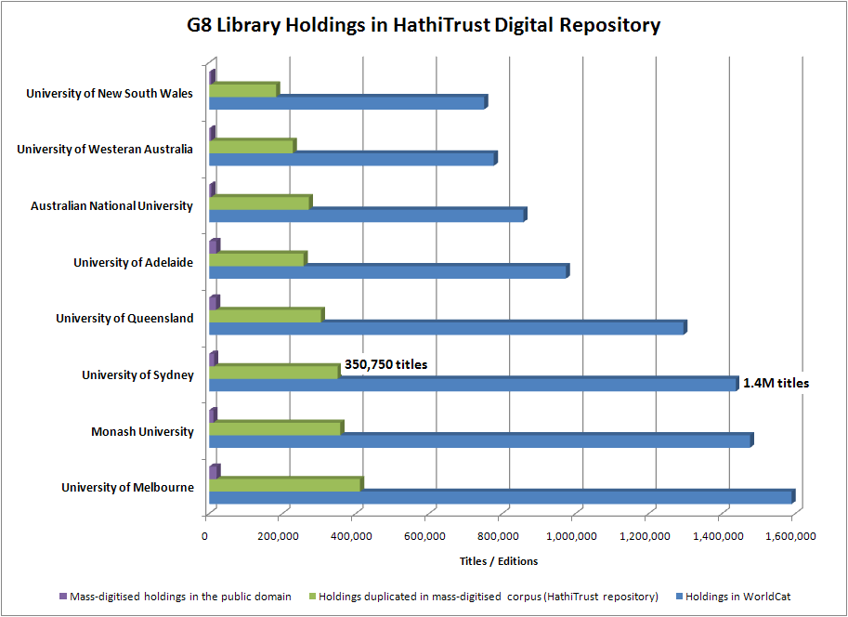

Australian research library collections
As of June 2010, 25% of titles in G8 libraries are duplicated in mass-digitised corpus
Data current as of June 2010
Notes:
I’ve argued that academic libraries are a primary driver in the changed collections landscape. So it’s important to look at the degree to which Australian university collections are duplicated in the mass-digitised library literature.
This is a view of library holdings in the Group of Eight universities as they compare to holdings in the HathiTrust preservation repository. As of June, we find that about a quarter of titles in these libraries are duplicated in digital form. It’s not unreasonable to expect that at least some of these institutions may begin to revisit their library print collections in view of this duplication.

Slide 30
CAVAL member library collections
Median duplication = 23%
Median duplication = 15%
Data current as of June 2010
Notes:
Higher standard deviation because more disparate set of libraries.

Slide 31
Vice-chancellor’s perspective
Total cost avoidance for CAVAL members could exceed $7M p/a if management were outsourced to shared service provider
Data current as of June 2010
Based on estimated annual cost of $4.25 US to store book on campus (Courant, Nielson 2010)

Slide 32
Library director’s perspective
CAVAL members could regain more than 33K linear metres of shelf space
Data current as of June 2010
Notes:
Entails regarding CAVAL as a print archive and not merely a repository

Slide 33
CAVAL as shared print archive
Current CARM holdings include at least 61K mass-digitised titles
Represents opportunity to rationalise CAVAL member print collections in view of improved online discoverability
Reduce and redistribute total cost of ownership across CAVAL membership
Potential to off-set CAVAL member costs by offering pooled holdings as shared service collection to non-members
Requires a shift from depository to repository model

Slide 34
Current CARM holdings as surrogate source for CAVAL members
Monash $100K
450 linear metres
~7% of ‘target’ yield
Data current as of June 2010

Slide 35
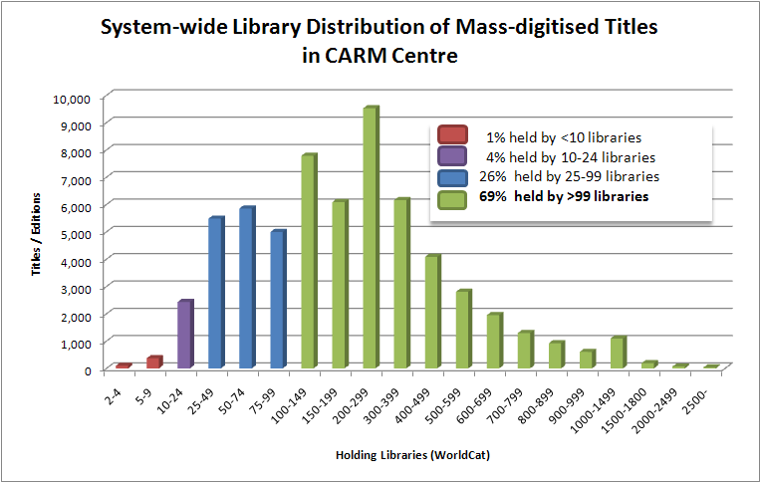
Scoping a market for shared print service
Low market potential
High market potential
Data current as of June 2010

Slide 36
Leveraging shared infrastructure
If low-use titles in your local collection are already
duplicated in mass-digitised collection AND held at CAVAL:
  maximise value of CAVAL membership by transferring use to shared copy
  integrate HathiTrust or Google Books API in local discovery system to provide full-text index search and reduce ‘frivolous’ request activity
If mass-digitised titles in your collection aren’t in CAVAL,
  transfer them post-haste ($4.25 volume v. $.86 volume)
  pro-actively increase business value of pooled collections

Slide 37
Leverage shared infrastructure (cont.)
Develop CAVAL strategy for digitisation of titles not already
represented in mass-digitised library collections
  Pre-1923 Australian imprints, theses/dissertations etc.
Consider CAVAL partnership with HathiTrust as
  A content contributor for preservation of CAVAL-digitised library materials, or
  A sustaining partner to participate in shared curation of mass-digitised corpus, without contributing any content

Slide 38
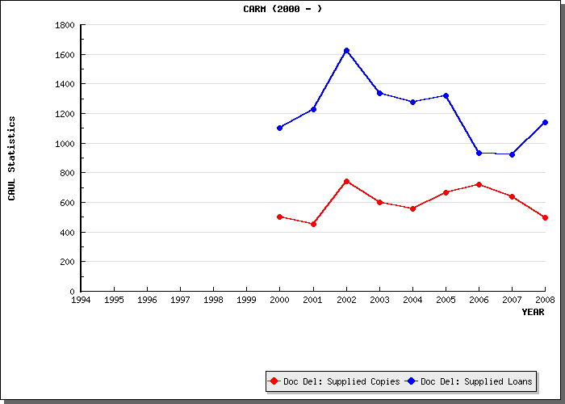
Modest demand for CARM holdings
Monographs show less dramatic decline
Notes:
So more returnable lending than document supply. And doc supply dropping while returnable lending hovers around 600 loans/year.

Slide 39
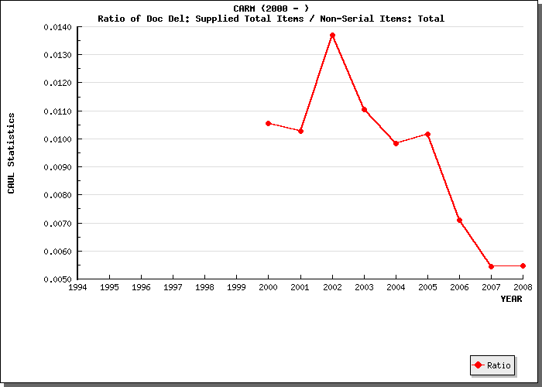
Transaction-based pricing is not the answer
Low retrieval rate = low operating cost
Notes:
But as a percentage of holdings, supply is on a sharp downward trend – from a high of 1.4% to less than 1 percent. Almost imperceptible supply. Suggests transaction based pricing for access to shared store is a losing battle. And subscription model not strong. Need to combine with strong message about preservation value of CARM and ability for other libraries to divest holdings. CAVAL should move more more widely held titles into the store.

Slide 40
For discussion
How will government plans to increase undergraduate enrollments by 50M students by 2013 affect university library planning? Viz. emphasis on teaching/learning, doing more with less
Are CAVAL members prepared to accelerate transfers to CARM2 based on duplication in the mass-digitised corpus?
Would digitisation-on-demand from CARM2 provide an acceptable means of gap-filling in existing corpus?
What is desired profile of shared digital service portfolio at CAVAL? Conversion service bureau, decision support, management infrastructure etc.

Slide 41
Thanks for your attention
Constance Malpas
malpasc@oclc.org
Comments, questions & corrections are welcome via email.

