Slide 1
Usage Consolidation & Analytics
Digital Interest Group
Jay Glaisyer, Senior Director of Sales

Slide 2
Usage Consolidation & Analytics
WHAT
IT IS
WHAT
IT DOES
BENEFITS
EBSCONET

Slide 3
WHAT
IT IS
UC is a vendor neutral product that provides a central place to gather, store and analyse statistics which are mapped to a single record thus providing details of consolidated use.

Slide 4
WHAT
IT DOES
Maintains and archives statistics for all econtent to make better informed collection development decisions for ejournals and ebooks

Slide 5
BENEFITS
Single place to go to manage statistics
Easy to use
Allows you to generate multiple reports about usage
Integrates with EBSCONET subscription management to create cost per use

Slide 6
EBSCONET
Usage and cost per use information is available in many areas including Orders, Renewals, and E-Packages
Integration also allows the library see holdings and usage broken out by month and platform to help with collection decisions.
Provides multiple analysis views including trend analysis

Slide 7
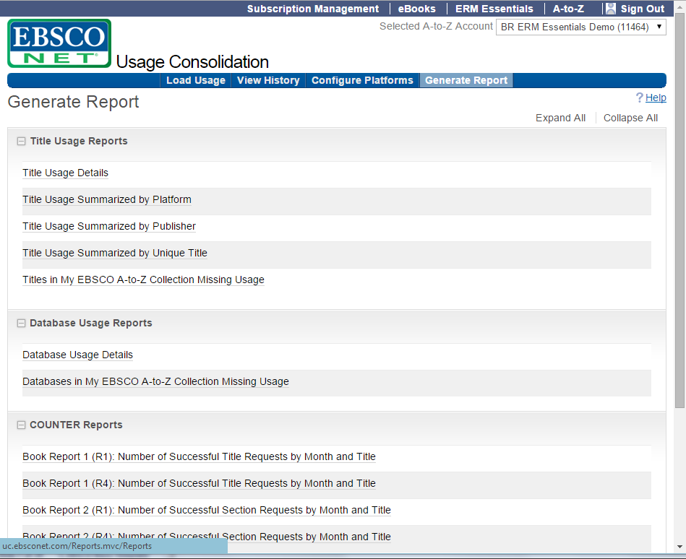

Slide 8
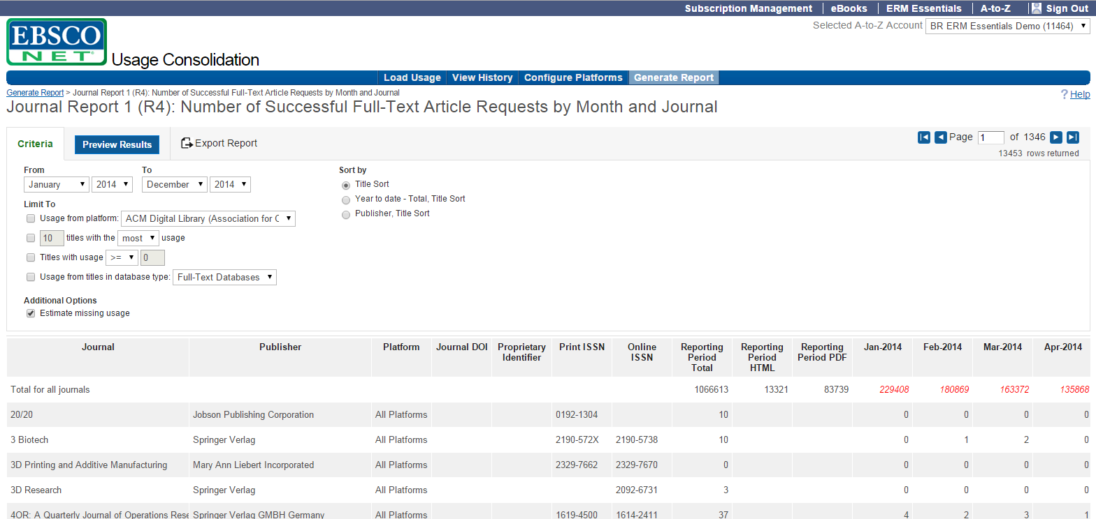

Slide 9
EBSCONET Subscription Management Individual Order Dashboard

Slide 10
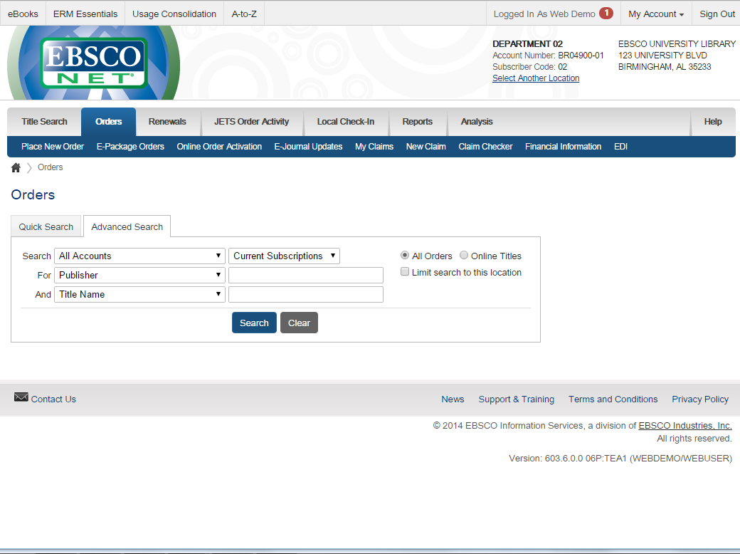
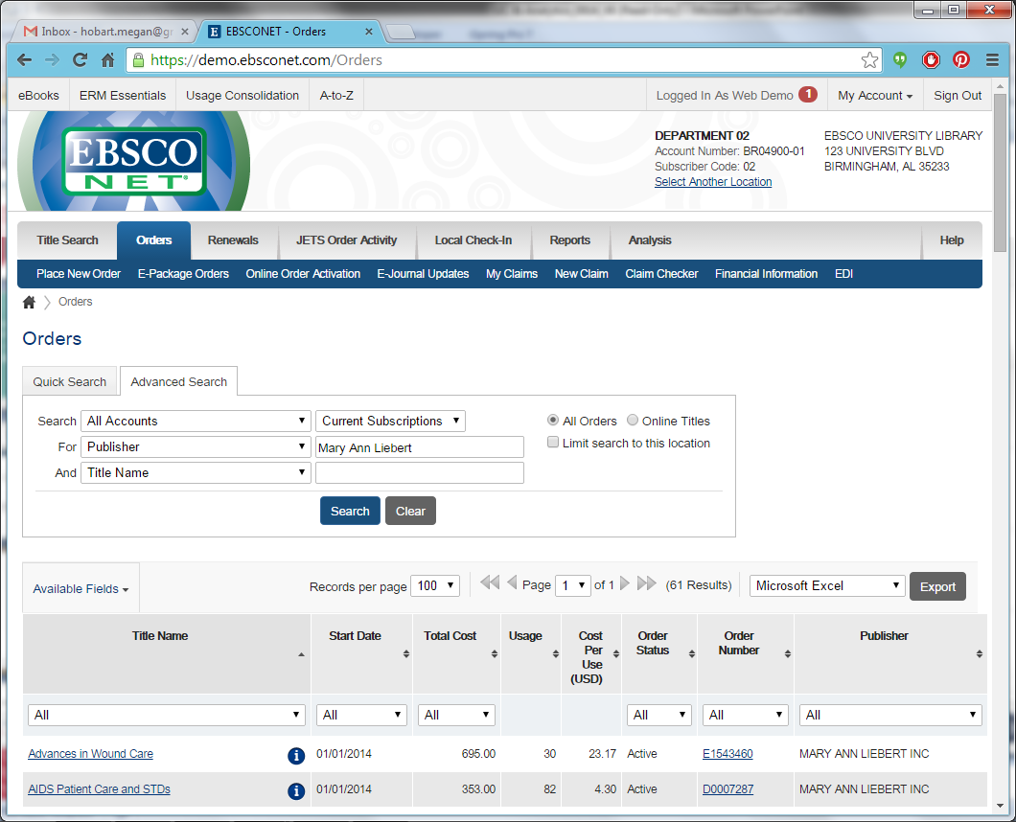
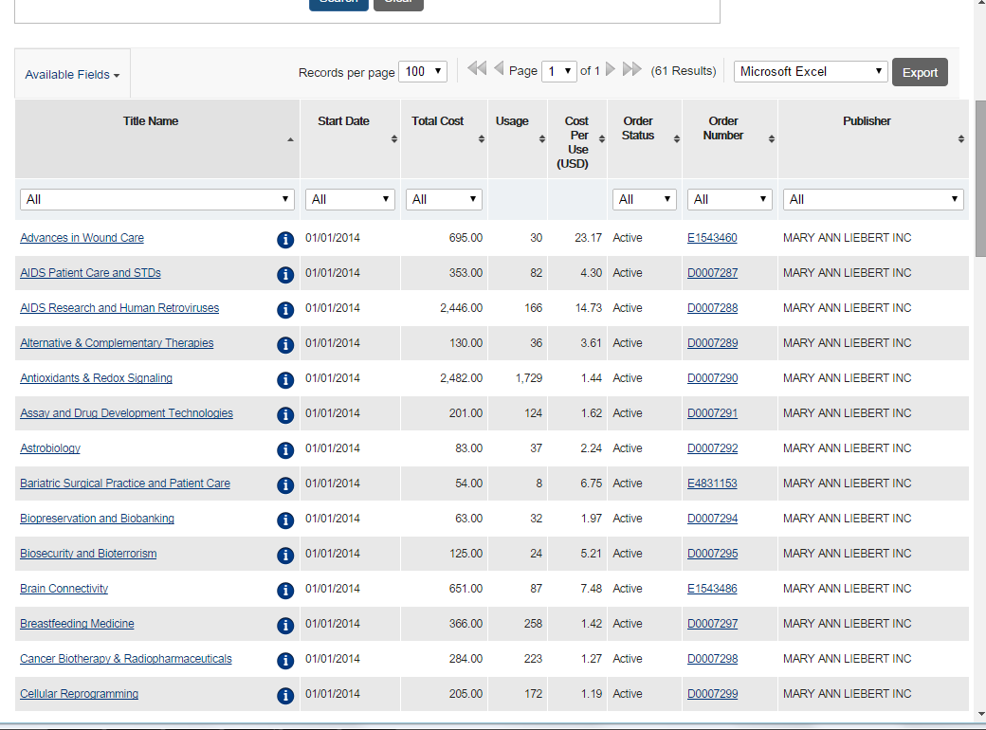

Slide 13
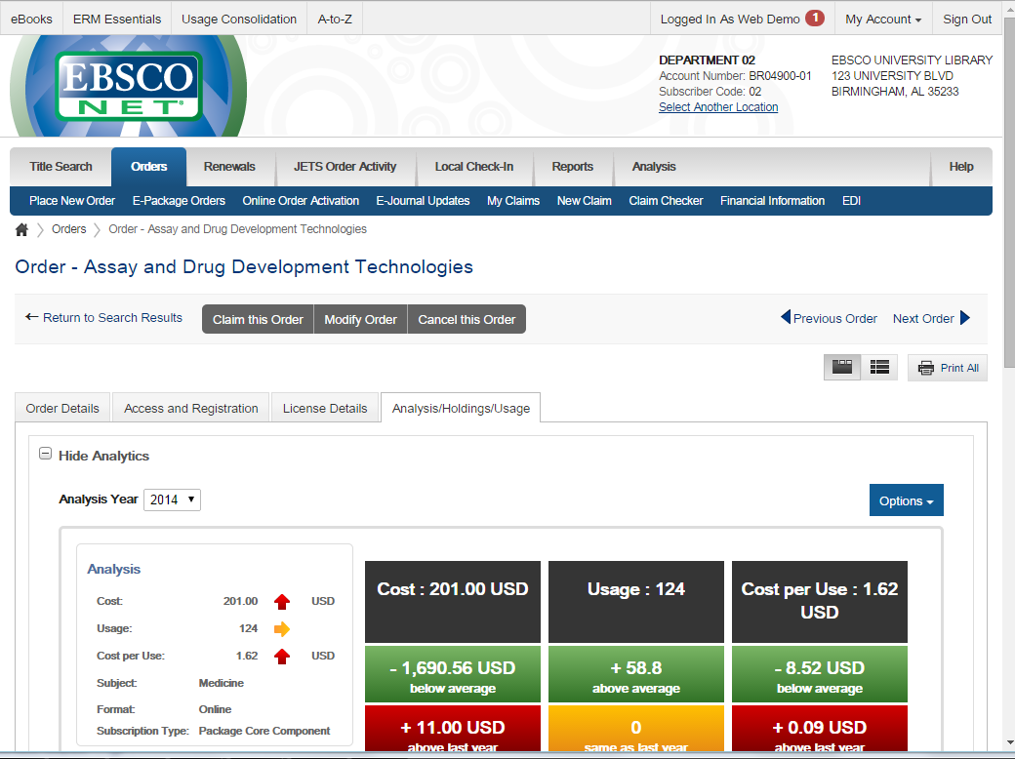
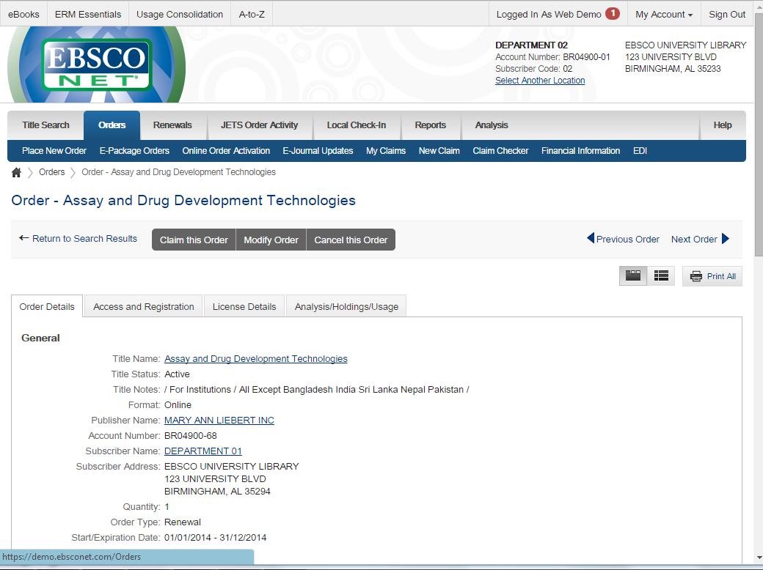
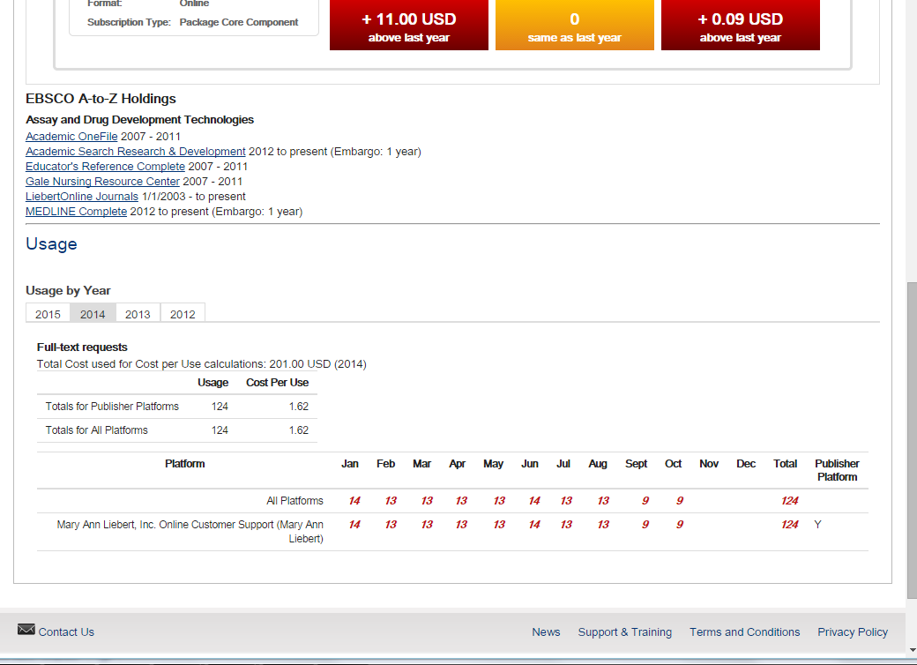
Knowledgebase Holdings
Shows availability and coverage from all sources.
Usage Details
Usage for multiple platforms and years.
Order Analysis Dashboard
With indication of trends compared to the previous year and to other titles in this subject.

Slide 14
EBSCONET Subscription Management Package Dashboard

Slide 15
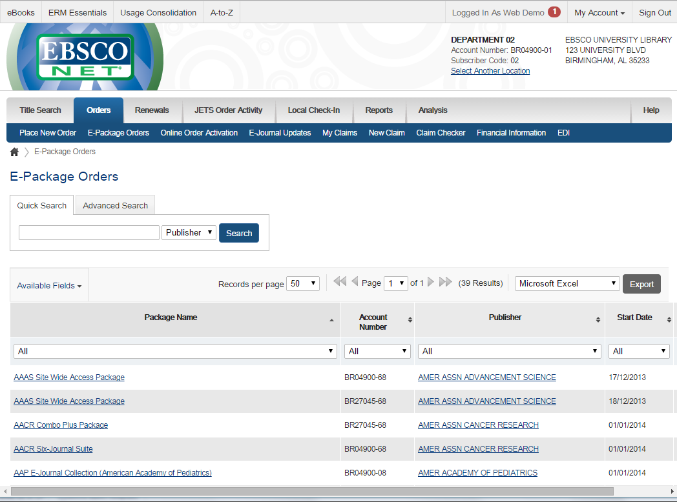
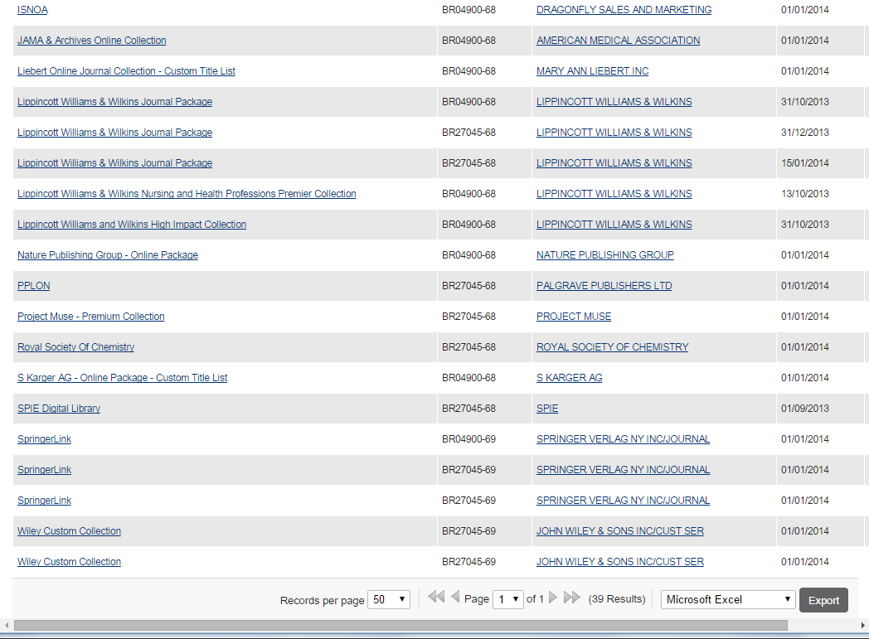
To see a package dashboard, start with “E-Package Orders”
Click on a package name to view the package details

Slide 16
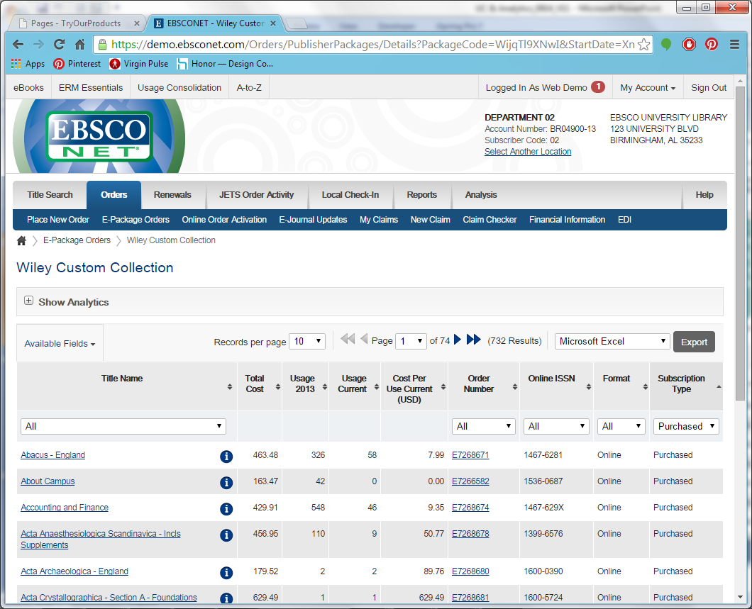
Grid display includes cost of journal, previous year usage, current year usage, and cost per use calculated on current year.
The package details includes a list of all the titles (orders) within the package

Slide 17
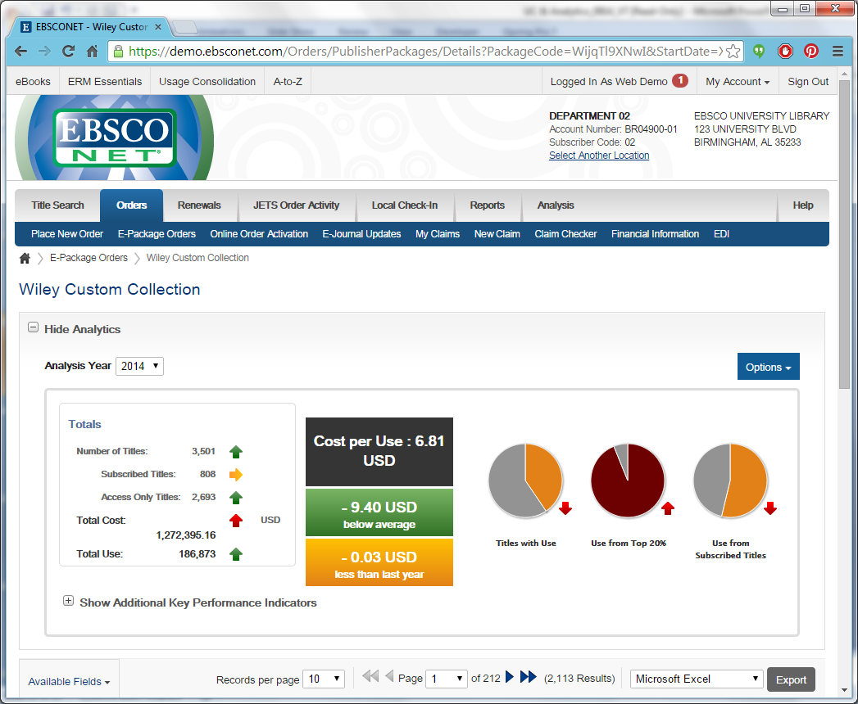
Pie Charts Showing:
what portion of the titles in this package had use;
what portion of use came from the top 20% of the titles (by use);
how much use came from subscribed (core) titles.
Cost per Use (total cost of the package divided by total use);
Compared to the average for all subscribed packages;
Compared to the Cost per Use for this same package last year.
Click on “Show Analytics” to see the package dashboard (option to show/hide by default)
Chart colors indicate if these metrics are good, bad or insignificant (the user can set the color ranges within Options/Preferences)
Package Analysis Dashboard
Totals for this package, with indication of trends compared to the previous year.

Slide 18
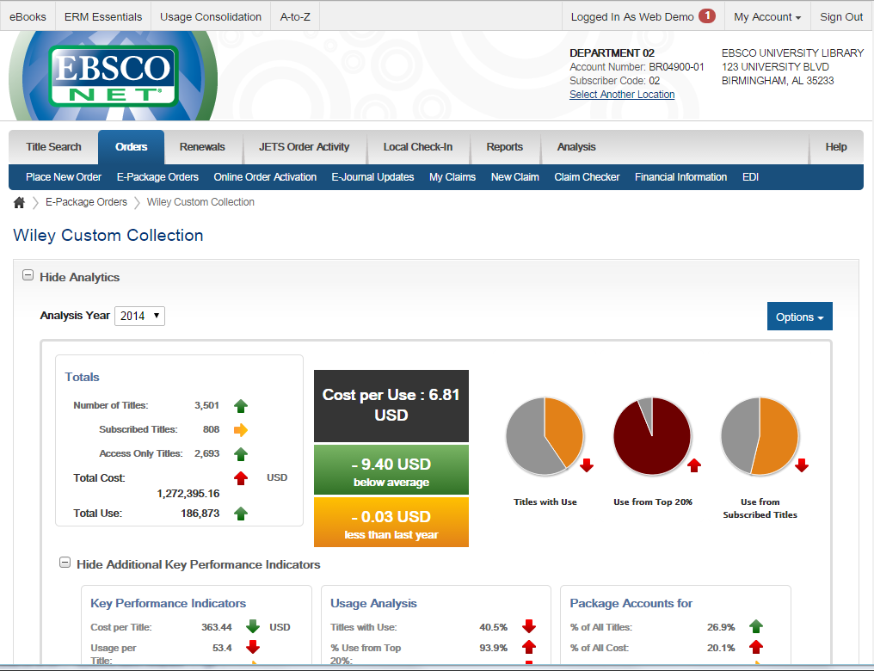
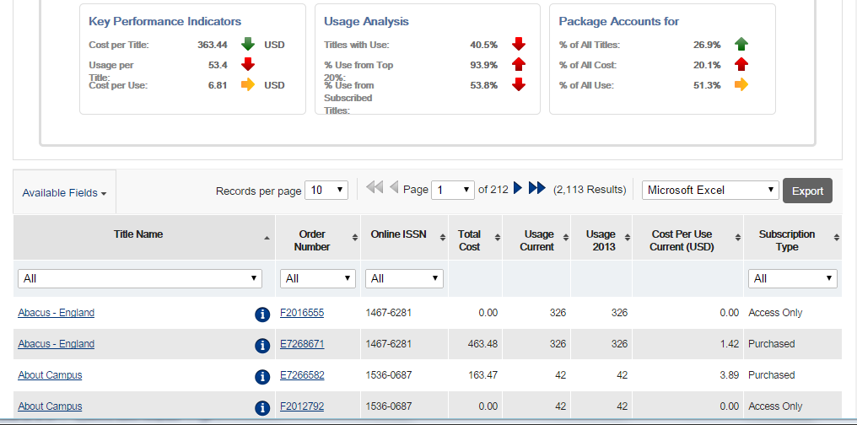

Slide 19
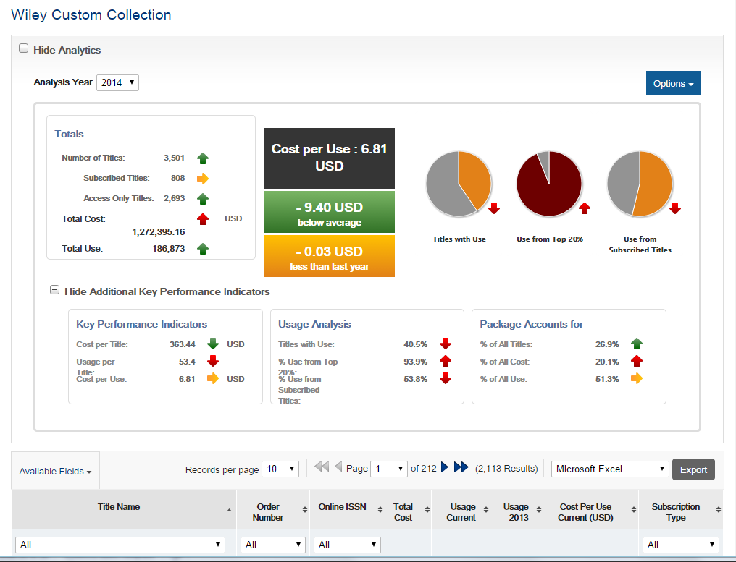
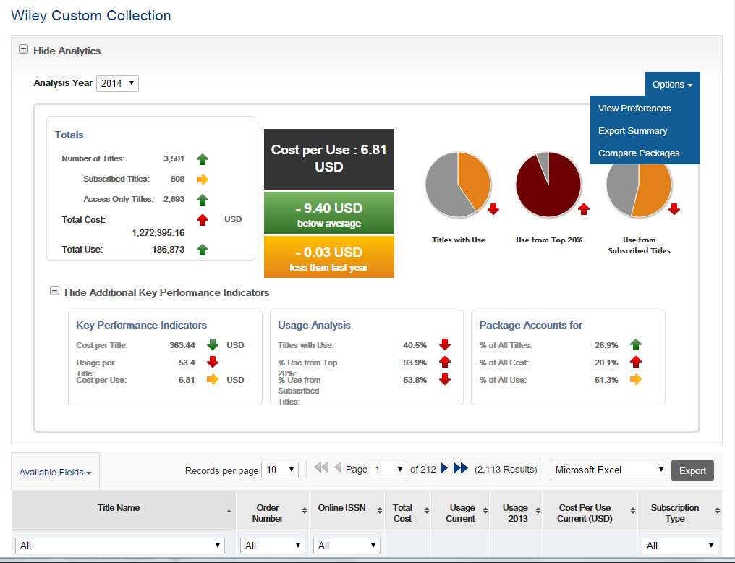
The “Options” button expands to provide access to “Preferences”, to export a summary of the metrics for the package as well as a package comparison report.
“Compare Packages” allows one or more of the library’s packages to be selected and a summary file created.

Slide 20
EBSCONET Subscription Management Analysis Reports

Slide 21
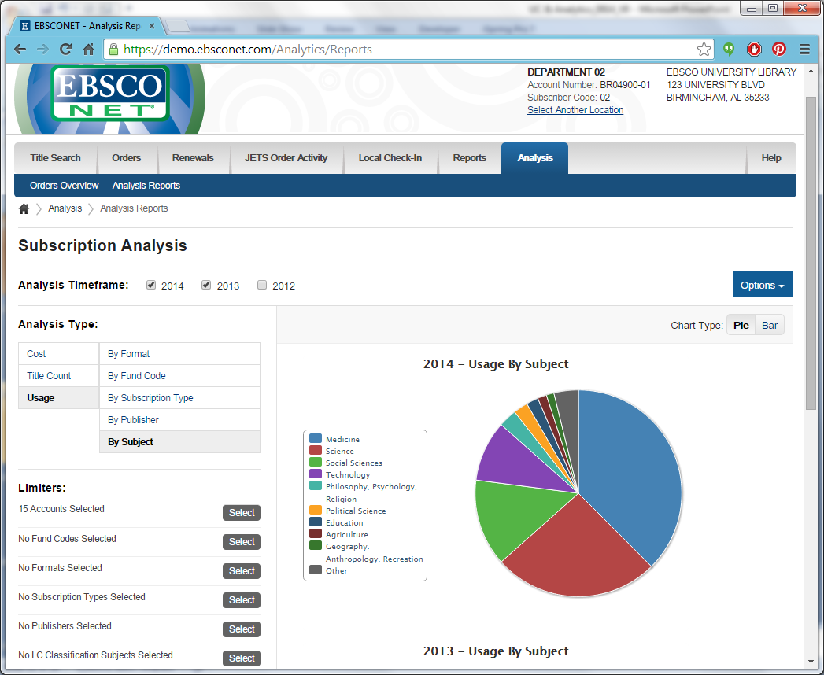
The user can select one or multiple years.
Pick the metric (cost, titles, usage) and how to analyze that metric.
Multiple options for limiting your dataset

Slide 22
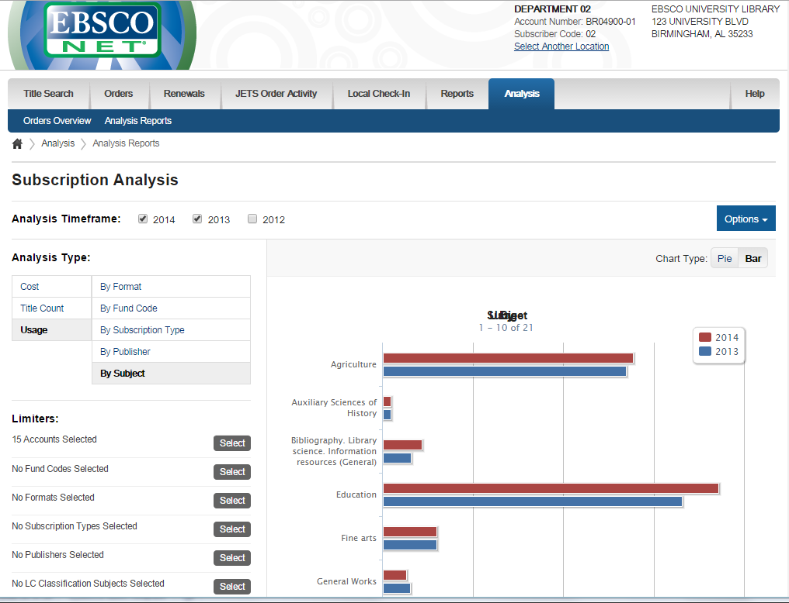
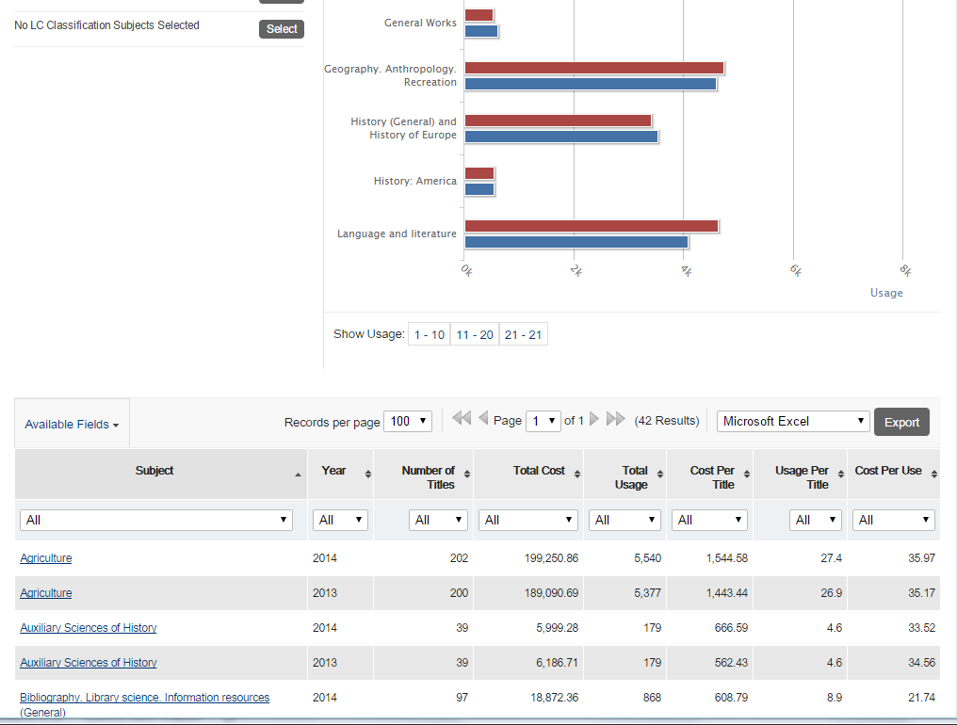
Option to view data as a pie chart…
…or as a bar chart (easier for comparing usage from multiple years)
Detailed view of data in the chart above
Usage by Subject

Slide 23
EBSCONET Subscription Management Orders Overview

Slide 24
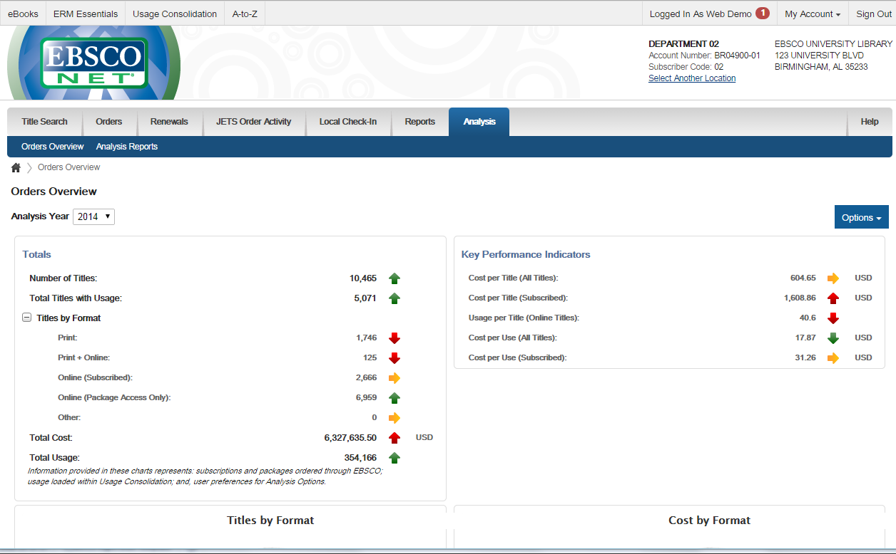
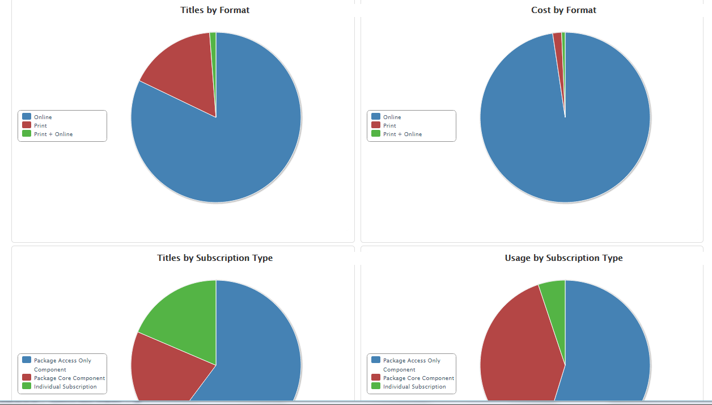
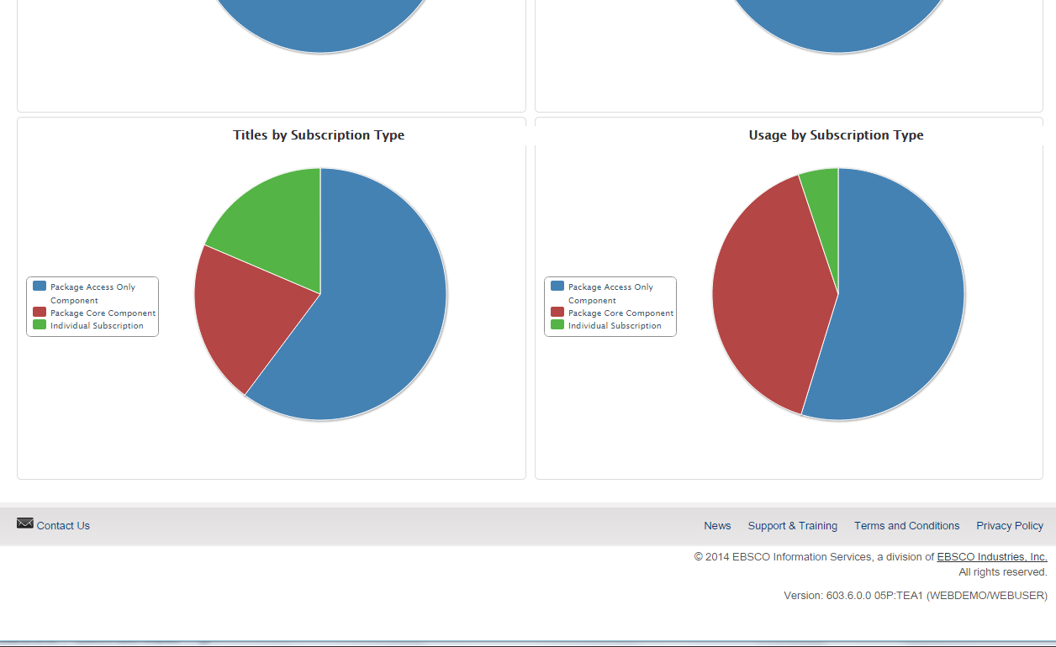
This feature gives you a high-level overview of your entire EBSCO subscription collection—showing cost, title counts, and usage by format and by subscription type.

Slide 25
EBSCO Usage Loading Service
Spend less time loading usage data and more time creating the best collection for your users

Slide 26
With EBSCO’s USAGE LOADING SERVICE EBSCO will:
Set up content host platform details within your account (including setting up SUSHI, where applicable)
Retrieve COUNTER reports from content providers (JR1, DB1, DB2, BR1, BR2)
Manipulate publisher usage files (clean up COUNTER reports and non-COUNTER reports to ensure that they load)
Load usage reports into your account and map all titles to central record
Load historical usage data (up to two years, where available)
Research all missing titles and add to EBSCO’s integrated knowledge base as appropriate
Communicate with content providers about statistic-related issues
✓
✓
✓
✓
✓
✓
✓

Slide 27
Usage Consolidation & Analytics
Thank You

