Slide 1
Virtual networking.

Slide 2
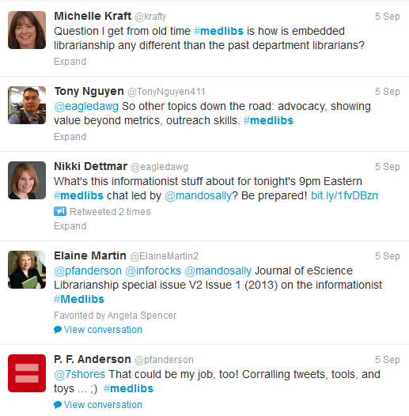
#Medlibs tweet-up
Notes:
A couple of examples of networking in the online environment – one industry based, and one workplace based.
http://medlibschat.blogspot.com.au/
Began in June, 2012.
1 hour weekly chat on twitter, started in the US (11am Fridays Australian EST).
Moderator with a selected topic most weeks. It’s currently in the 5th week of a series about eScience.
Benefits: Useful for sharing ideas, getting a feel for what others in the world are doing in their services, but also their opinions. Sometimes it’s a sounding board, sometimes it seems to generate momentum ie hospital libraries promoting their services, the changing role of the health librarian, opporutnities for professional development.
Drawbacks: I don’t always want to know what people are watching on tv, but it does make an avatar with 40 characters a bit more human. The timing is always US centric. My European and African counterparts are highly unlikely to take part.
I used Twitter and the #medlibs in a conference to track people down to meet them face to face. This was a positive loop – once I’d met them face to face, they were more likely to respond to me on Twitter.
Transcripts of the hour are saved – easy to refer back to shared links
How did I find it? I honestly can’t remember. I think it was when I was initially exploring/ stalking on Twitter, and found the writer of a medical librarian blog. I followed the hashtags from there.
Is it likely to replace e-lists? Not yet, not while the conversation is public.

Slide 3
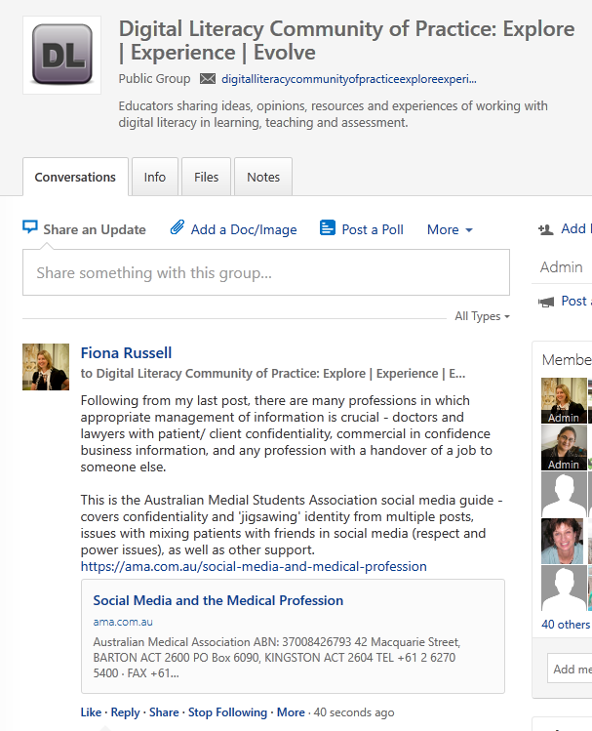
Digital literacy community of practice
Notes:
Workplace based, open to Library staff and academics
Various platforms discussed. Yammer selected to allow for conversations and file storage. Already used by staff.
Early days yet. Opportunity to share experiences and ideas, examples from practice. Sharing articles, videos and tools.
Communication plan to Client Services, then an email tailored for academics for liaisons to send out to unit chairs
A Community of Practice should be organic, but may require some moderation. A month long, rolling roster has been generated, with each Faculty liaison team responsible for posting at least one relevant Digital Literacy article link during each week of their month, with a brief comment. If the space is quiet, this guarantees at least some activity.

Slide 4
Questions?
Phone or email Fiona (5227 2862 or f.russell@deakin.edu.au)

