Slide 1
Building relationships on trust and sustainability the Global Learning by Design Project
“In organisations, real power and energy is generated through relationships. The patterns of relationships and the capacities to form them are more important than tasks, functions, roles and positions”.
Margaret J Wheatley
Spiros Soulis
@SSoulis
Office of the Dean Learning and Teaching
RMIT University
Notes:
quote by us writer margaret wheatley
Twitter feed
In my experience whether leading mountaineering expeditions or managing major projects …forming relationships is critical to successful outcomes

Slide 2
Notes:
RMIT is a large organisation, with over 5,000 staff in which over half of those are non-teaching, professional , administartive technical working together on what I have classified in about 20 different areas…...and we have meetings and emails, and processes but are we communicating are we establishing sustainable relationships built on trust and are we making friends in the right places?

Slide 3
In organisations, real power and energy is generated through relationships. The patterns of relationships and the capacities to form them are more important than tasks, functions, roles and positions.
Margaret J Wheatley
Notes:
opportunites to collborate come along such as GLbD
we are told we need to collborate with key stakholders such as the library and study and learning center
so we look at how our values align

Slide 5
Agile Curriculum Design Teams
“As its foundation the project establishes Curriculum Design Teams (CDT) which include academic and support staff that work together using Agile methodology to create Learning Objects that are captured as patterns for reuse by other discipline areas” (Nicolettou & Soulis, 2014).

Slide 6
Curriculum Design Teams:
Acadmic/Teaching Leads, Educational Developers, Instructional Designers, Liason Librarians, Production, Study and Learning Center, Careers and Students
Notes:
Involving all stakeholders from the outset… that includes the library

Slide 7
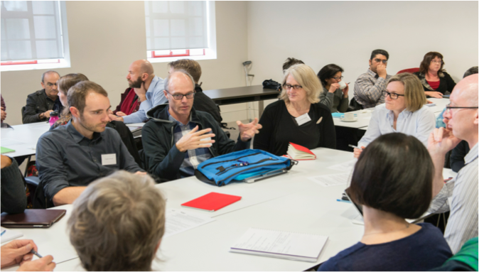
Notes:
harnessing the human capital, getting everyone in the room at the same time, building trust

Slide 8
Cultures of Participation (Fisher, 2011)
motivation - IKEA effect (Ariely, 2010) - like if involved
“misused” (Fisher, 2011) if bought in later in the process
Notes:
community of learners

Slide 9
Agile Principles:
face-to-face meetings;
identifying motivated individuals;
building trust;
technical excellence; and
good design

Slide 10
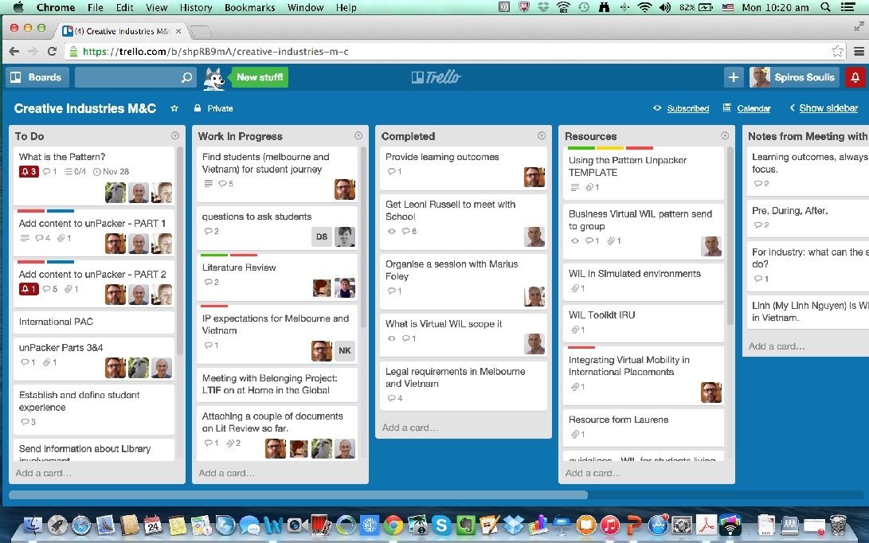

Slide 11
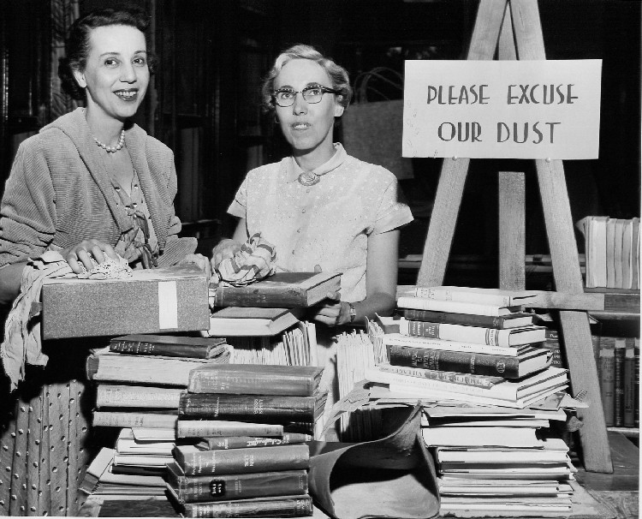
Notes:
Move away from this thinking to one where the library, is about research skills, digital guides, curriculum development, pushing the online space, embracing the digital, sharing in the work and outcomes

Slide 12
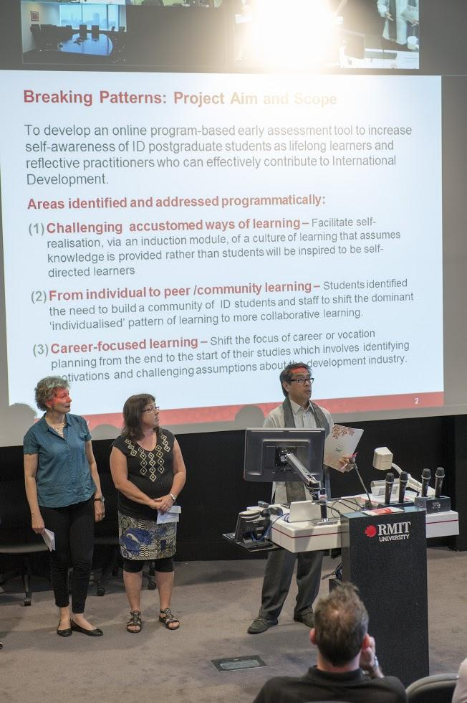

Slide 13
Patterns/Challenges
align visions
genuine engagement from outset
tangible outcomes
celebrate and acknowledge participation
participation overload (Fisher, 2011)

Slide 14
Global Learning by Design

Slide 15
Spiros Soulis
spiros.soulis@rmit.edu.au
Angela Nicolettou
angela.nicolettou@rmit.edu.au

